Slide 1
Intro to HTML/CSS

Slide 2
Agenda
Introduction
Intro to HTML
Intro to CSS
Setting up people.tamu.edu websites (personal TAMU websites)

Slide 3
Helpful programs for this course
The programs below are recommended but alternatives can also be used
Text editor:
Visual Studio Code (https://code.visualstudio.com/)
FTP file transfer program:
WinSCP (Windows): (https://winscp.net/eng/index.php).
Filezilla (Windows, Mac, Linux): (https://filezilla-project.org/)
Git:
Command line utility: (https://git-scm.com/)
PostgreSQL:
For PostgreSQL database: (https://www.postgresql.org/)

Slide 4
What is HTML?
Hypertext Markup Language
Markup language, standard front-end language for web development
Terminology:
<p style=”display:block”> This is a paragraph. </p>
<p style=”display:block”> This is a paragraph. </p>
Tag
Element
Attribute

Slide 5
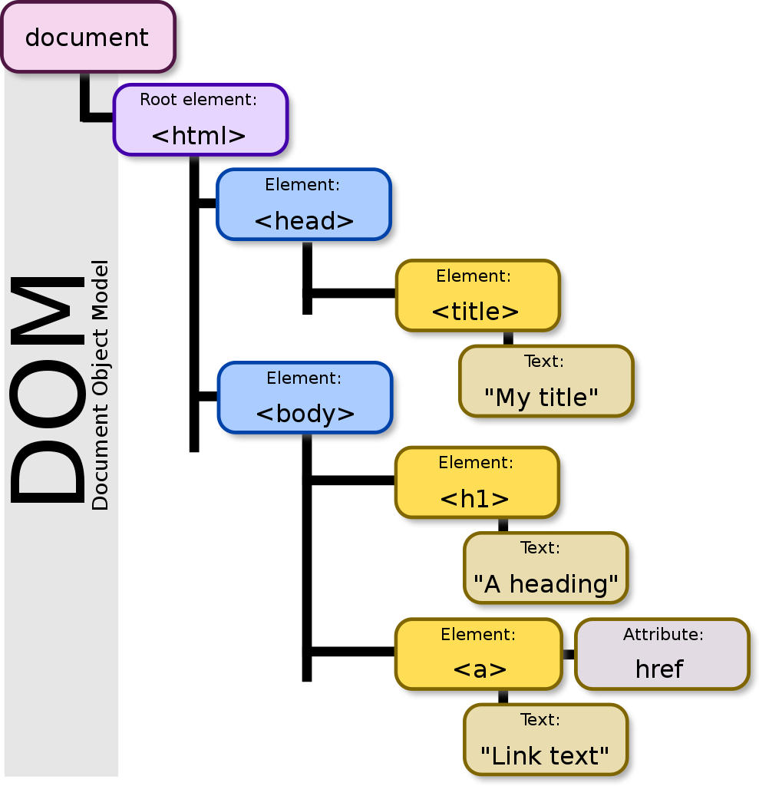
HTML DOM
Document Object Model
Web browsers use a similar representation under the hood
https://upload.wikimedia.org/wikipedia/commons/thumb/5/5a/DOM-model.svg/989px-DOM-model.svg.png

Slide 6
Create index.html file
<!DOCTYPE html>
<html>
<head>
<title>Your Name</title>
</head>
<body>
<h1>Your Name</h1>
<p>Welcome to CSCE 315 Lab!</p>
</body>
</html>
Tells browser this is an HTML5+ document
Starts HTML document
Metadata
Appears on browser tab
Visible part
Heading
Paragraph

Slide 7
Hyperlinks
Clickable links for providing navigation
Internal link: to other pages on your website
External link: to other pages on the internet

Slide 8
Create new file about.html
Pro Tip: in VS Code you can type “!” and then press enter in an empty .html file to auto generate boilerplate HTML code!!!
<!DOCTYPE html>
<html>
<head>
<title>About Me</title>
</head>
<body>
<h1>Your Name</h1>
<p>My about page</p>
<a href="index.html">Home</a>
</body>
</html>
Link to index.html

Slide 9
Modify index.html page
<!DOCTYPE html>
<html>
<head>
<title>Your Name</title>
</head>
<body>
<h1>Your Name</h1>
<p>Welcome to CSCE 315 Lab at <a
href="https://www.tamu.edu/">Texas A&M</a>!</p>
<a href="about.html">About</a>
</body>
</html>

Slide 10
Comments - HTML
<h1>Your Name</h1> <!-- This is a comment! -->

Slide 11
Inline vs Block Elements
Inline element: does not disrupt flow of text (by default)
Example: This is <strong>bold text</strong>!!!
Block element: generally changes layout of text (cannot be inside inline elements)
Example: <p>Paragraph text</p>
Other text/elements can come before and after!
The paragraph element occupies its own line

Slide 12
Live Server and browser debugger demo
Live Server is a VS Code extension that allows you to run JS on your HTML file (we’ll go over this next time!)
Browsers have debuggers:
Firefox: 𝄘 → Web Developer → Debugger
Chrome: ⠇ → More tools → Developer tools
MS Edge: ⠐⠐⠐ → More tools → Developer tools
We will use these more next time!

Slide 13
HTML file
<html>
<head>
<title>Your Name</title>
</head>
<body>
<h1>Your Name</h1>
<p><strong>Welcome to CSCE 315 Lab!</strong></p>
<img src="https://brandguide.tamu.edu/assets/img/logos/tam-box-logo.png"/>
<a href="about.html">About</a>
</body>
</html>

Slide 14
Intro to Cascading Style Sheets (CSS)
CSS: style sheet language for defining web-page styles
Like JS can be either embedded into the HTML file or externally linked
Terminology:
Rule (Ruleset for multiple selectors)
Selector
.blue_overline_text {
color: blue;
text-decoration: overline;
}
Declaration
Property
Value

Slide 15
CSS types of style sheets
Inline CSS
Defined in element tag:
<p style=”color:red;”>...</p>
Internal or Embedded CSS
Embedded within HTML
External CSS
CSS written to a separate file (e.g., “style.css”)

Slide 16
New file: style.css
Type Selector
h1 {
color: grey;
}
.blue_overline_text {
color: blue;
text-decoration: overline;
}
#red_underline_text {
color: red;
text-decoration: underline;
}
Class Selector (“.”)
ID Selector (“#”)

Slide 17
Comments - CSS
h1{
color: blue; /* This is a comment! */
}

Slide 18
Modify index.html
<html>
<head>
<title>Your Name</title>
<link rel="stylesheet" type="text/css" href="style.css"></link>
</head>
<body>
<h1>Your Name</h1>
<p>Welcome to CSCE 315 Lab!</p>
<p class="blue_overline_text">Blue paragraph</p>
<p id="red_underline_text">Red paragraph</p>
<button type="button" onclick="button1()">Increment</button>
<p id="output"></p>
<script src="functions.js"></script>
...
</body>
</html>

Slide 19
Setting Up OAL Account
Follow these instructions:
http://people.tamu.edu/Getting_Started/Setting_Up_a_TAMU_Personal_Website.php
Notes:
Walk through instructions with students

